Slide 1
Automatic Sentence Tagging System
2010030329 - S SIVA KARTHIK REDDY
2010030325 – P SAI MANASWI
2010030051 – E R SUMANTH
2010030341 – K SNEHITH
2010030033 – C SAI SANTOSH REDDY

Slide 2
INTRODUCTION
Tagging is a method used to classify data such as image, audio, sentence.
Tagging of sentences comes under the domain of ‘natural language processing (nlp) in machine learning’.
Tagging is used to classify the data to topics/classes.
It is used in daily life applications like recommendation, part of speech tagging, similar or related topics recommendation

Slide 3
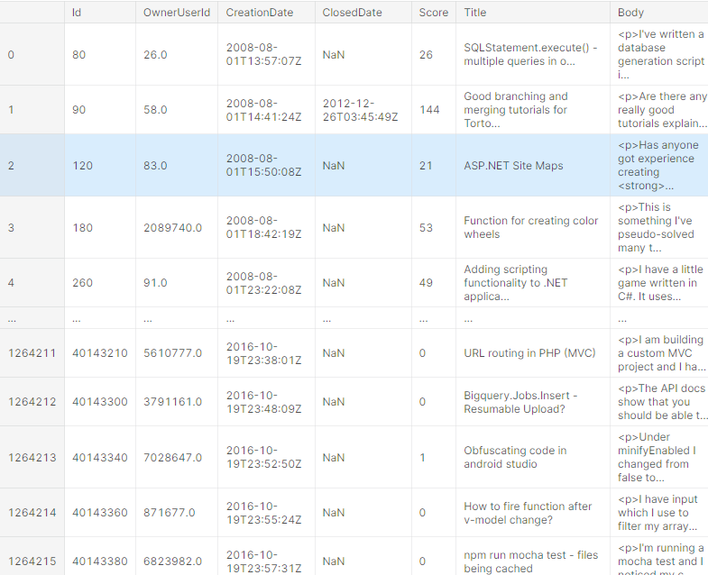
DATASET

Slide 4
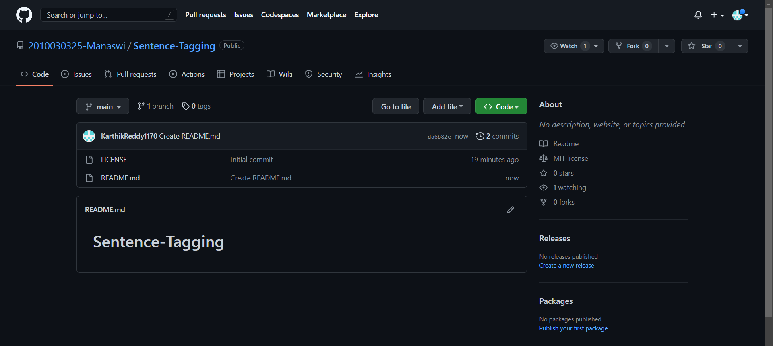
GIT HUB SETUP

Slide 5
